Slide 1
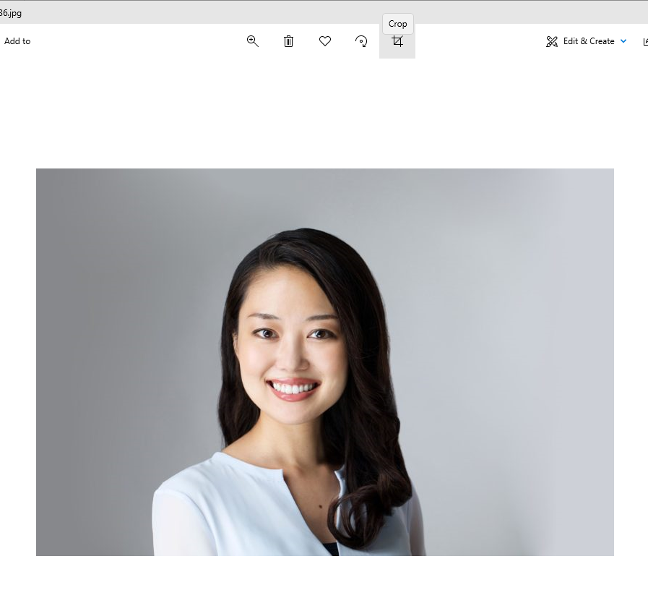

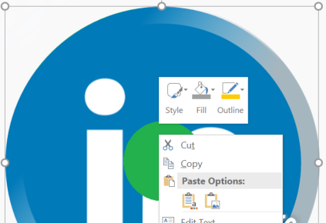

How to use the filters
Showcase your NAMSS pride during Celebrating Diversity Month with #IAMNAMSS filters by following these steps.
Note: Certain filters will require your picture to be cropped into a square before use.
1) Double click the green target on placeholder image.
2) Right click the target to access the Fill option.

Slide 2
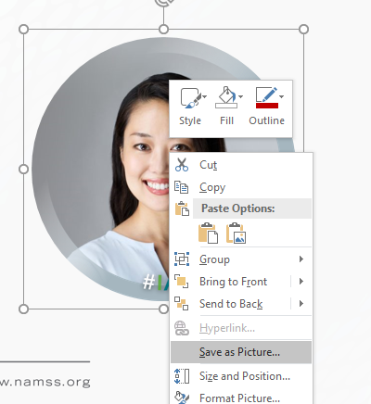
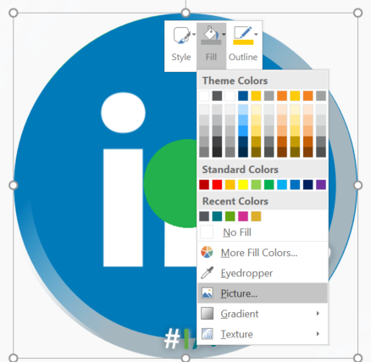
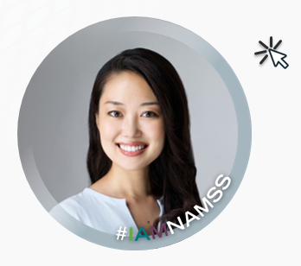
How to use the filters
3) Select Picture to choose your image saved to your computer.
4) Click out of your image to admire your work.
5) Right-click image and select Save as Picture.

Slide 3
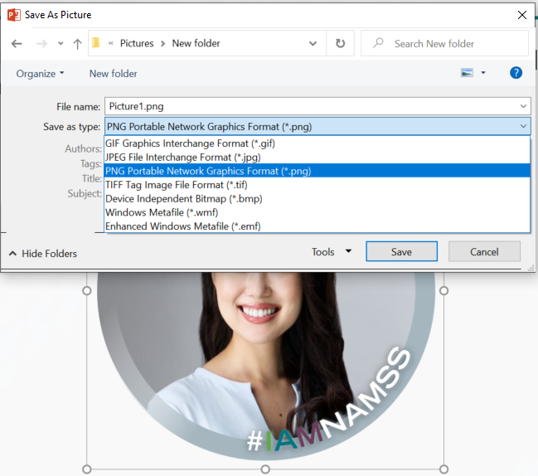
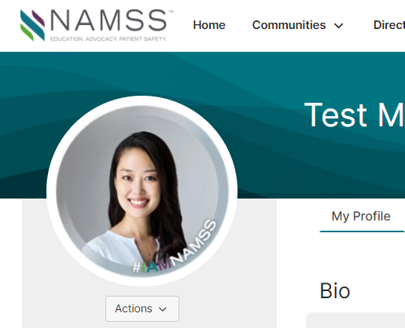
How to use the filters
6) Save your new picture by selecting a name and desired file type.
7) Upload your picture to your social media profile.

Slide 4




Sample pictures

Slide 5


Connection Zone or LinkedIn Profile
Please note: Your picture should be cropped into a square before replacing the placeholder image.

Slide 6


Facebook or Instagram Profile
Please note: Your picture should be cropped into a square before replacing the placeholder image.

Slide 7


Social Media Posts

Slide 8


Social Media Posts

