Slide 2
Week 1
Introduction & Credentialing
Notes:
Welcome to the first Virtual Instructor Led Session of the Blended CPMSM certification preparation course!

Slide 3
Hello!
Insert Instructor Bio and Photo
Insert Instructor Bio and Photo
Notes:
Briefly introduce yourself giving participants:
Your name and background
Your personal goals for the course (or this can wait until the Ice Breaker activity and the instructors can add their own goals on the whiteboard).
Emphasize that the course will give them a lot of information but will also be fun.

Slide 4
Ground Rules
Participate, Participate, Participate
Keep an Open Mind
Stay Present
Be Respectful
Be Brave
Ask Questions
Have Fun!
Notes:
Since our time together is short, we want to lay out some ground rules
Participate, participate, participate – this session will only be successful if you stay involved. The more active you are the more you’ll get out of this!
Keep an Open Mind – some concepts might be new or foreign, remain open and receptive as you learn about new methods and processes
Stay Present – it can be hard with a virtual meeting. But silence that cell phone, close any other tabs you have open and stay with us
Be Respectful – all opinions and questions are valid – be respectful in your conversations with peers.
Be Brave – this virtual space and zoom tool may be new or unfamiliar to you. Don’t let that keep you from fully participating and getting the most out of this program.
There are No Dumb Questions – it’s true – we don’t expect you to know everything and we are happy to provide the answers.
Have Fun! – Most important one – relax and enjoy yourself, by the end of this program you will be much better situated to prepare yourself for a successful CPMSM exam.
Ask: Please raise your hand if you agree to follow these rules and are ready to continue. If you aren’t comfortable or want to add something to this list please enter it in the chat and we can talk about it.
Wait for participant responses, if any appear unmute the individual and address their concern. Once everyone is ready, move on to the next slide.

Slide 5
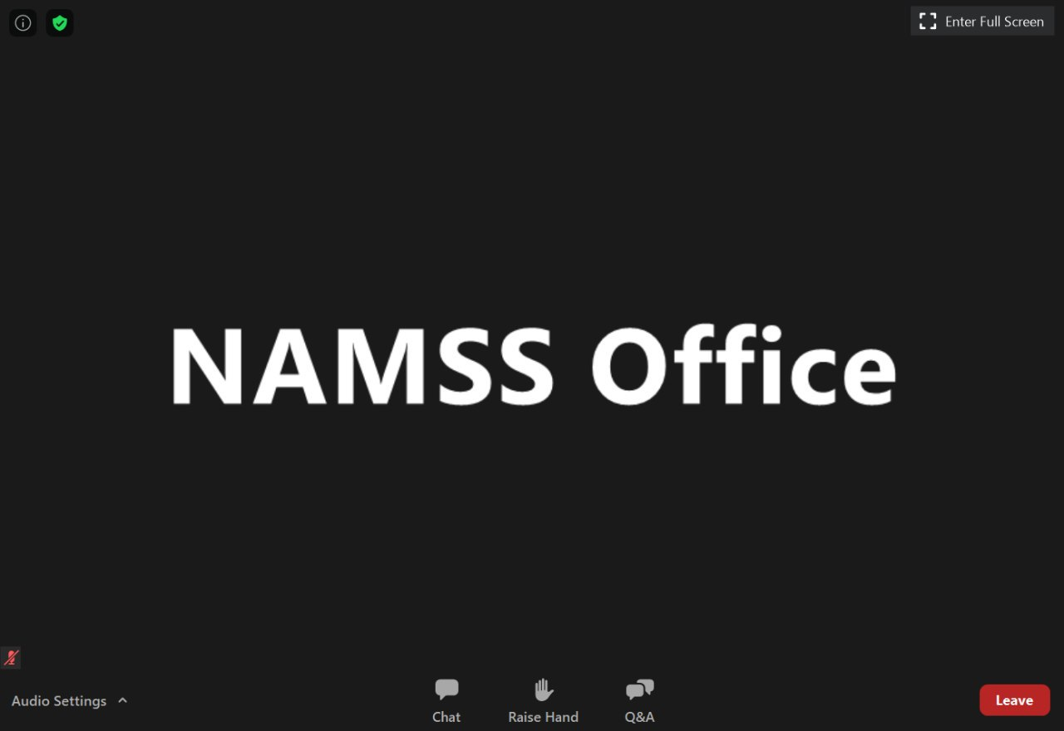
Zoom Instructions & Ice Breaker Activities
Notes:
Practicing features and the icebreaker activity as people get comfortable with the technology.
See their screen where they can chat, ask questions or raise their hands. In the chat box you’ll see a drop down to ask all panelists or all panelists and attendees.
To ensure you all see where your chat box is, please open that up and type in the number of years experience you have in the medical services profession.
Ask if anyone has ever heard the expression “No one of us is as smart as all of us.”
Explain that you and other instructor(s) have x years of experience, which is nowhere near the amount of experience in the room. You will be facilitating the class and sharing your experience, but there is a great resource available in each other
An additional feature of Zoom that we’ll be taking advantage of today is the whiteboarding feature.
Instructor to start whiteboard
Have participants write in:
One personal goal for the course (clear white board between questions)
One potential concern

Slide 6
Agenda
Today we will…
Recap the CPMSM exam
Recap medical environments and management functions
Review the credentialing and enrollment processes
Application activities
Test your knowledge
Open discussion

Slide 7
Program Schedule
Week 1: Introduction & Credentialing
Online Modules
Zoom Meeting
Week 2: Privileging & Recredentialing
Online Module
Zoom Meeting
Week 3: Ongoing Monitoring & Compliance
Online Module
Zoom Meeting
Week 4: Department Operations & System Management
Online Module
Zoom Meeting
Notes:
As you saw on your online module and advertised online – here is the schedule for this blended learning program.
Ask audience if they have any questions about the schedule or accessing modules or zoom sessions.

Slide 8
Course Resources
Candidate Handbook
Consolidated Standards - AAAHC, HFAP, NCQA, TJC, URAC & DNV
Medicare CoP summary
Healthcare Regulatory Requirements
Meeting Management Core Curriculum
Responding to Requests for Information
Policy and Procedure Development
AMA Physician's Recognition Award and CME Credit System
NAMSS Certification FAQs
Key Legal Terms
Legal Case Summary
Robert’s Rules of Order
Notes:
**Instructor note: This information was covered in the online module so just quickly review and ensure everyone has been able to access the participant guide and know where the link is to access these resources.

Slide 9
NAMSS Comparison Grid
Access provided in your Online Education Center on the NAMSS website at https://www.namss.org/Education
Password required
Notes:
**Again – this is covered in the online module just make sure they are aware of the resource and how to access it**

Slide 10
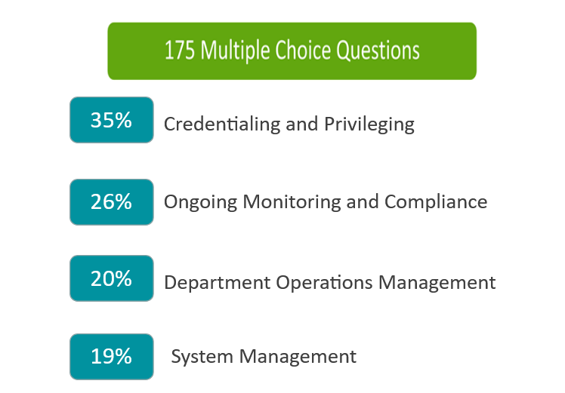
CPMSM Exam
On average over the past 10 years:
185 people sit for the exam every year
Average passing rate is 54%
In 2020, the passing rate was 50%
Notes:
Instructor discussed or NAMSS representative may attend.
Ask audience if they have any questions about the exam. Do not let this drag on too long, especially with specific exam questions.
Stop slide show so that all attendees are visible on the screen.
Limit to 15 minutes for presentation and Q&A.
For reference, last 10 years' numbers:
1851 total candidates
991 passed (54%)
860 fails (46%)

Slide 11
CPMSM Exam Resources
Candidate Handbook https://www.namss.org/Portals/0/NAMSS_2021%20Candidate%20Handbook.pdf
Frequently Asked Questions https://www.namss.org/Certification/Exam-Information/Certification-FAQs
Notes:
New Slide

Slide 12
Medical Environments
Notes:
Medical environments – we talked about the various types of medical environments in which medical services professionals and managers may be working.
POLL: Ask audience in which environment they currently work – hospital, CVO, health plan, ambulatory care/surgery center, provider organization.
Debrief
Work with the NAMSS staff member to run through the polling question. Discuss answers as they are projected onscreen.
Ask about any attendees that select “Other” on the poll.

Slide 13
Credentialing Drivers
Notes:
Set this up as a white board activity – have participants write in what they think or what they’ve experienced in their organization. Credentialing drivers – what drives credentialing in these different types of medical environments?
Discuss federal/state regulations, accreditation standards, governing documents such as Bylaws, policies and procedures, rules and regulations, standard of care, contractual agreements.

Slide 14
Management Overview
Management is the achievement of the organization’s objectives through and with people and other resources.
Notes:
Management overview – we introduced the 5 functions of management which are Planning, Organizing, Influencing/Motivating, Staffing and Controlling
Below are several questions to generate discussion and ensure everyone is following.
Create polling Questions:
1. True or False: Only medical services managers perform these management functions. False, just because you don't hold the title, doesn't mean you don't currently perform or may be responsible for these management functions in the future.
2. Multi-Choice: Budgeting falls under which management function? Budgeting falls under both Planning and Controlling.
3. "Under what function do the following items fall? Identifying the roles and responsibilities, assigning duties to staff as well as the level of supervison, coordinating the activities and teams to achieve department objectives." Organizing

Slide 15
Importance of Credentialing
The primary purpose of credentialing is to protect our patients.
Notes:
Importance of credentialing – primary reason is to protect patients, but we also want to protect the organization from negligent credentialing claims. We talked about the 4 elements required for a tort of negligence, such as breach of duty.
"In addition to breach of duty, can someone tell me the other 3 elements required for a tort of negligence?"
Answer: 1) Duty to exercise due care; 2) Injury; and 3) Proximate cause.
and also covered various liability theories, such as the Doctrine of Respondeat Superior (This long-standing legal theory places liability for an employee’s actions on the employer. Thus, the hospital can be held liable for the damages caused by a negligent nurse.) These may be covered on the exam, but not specific legal cases.

Slide 16
Importance of Credentialing
The primary purpose of credentialing is to protect our patients.
1) Duty of exercise due care
2) Breach of Duty
3) Injury
4) Proximate Cause
Notes:
Importance of credentialing – primary reason is to protect patients, but we also want to protect the organization from negligent credentialing claims. We talked about the 4 elements required for a tort of negligence, such as breach of duty.
"In addition to breach of duty, can someone tell me the other 3 elements required for a tort of negligence?“
Answer: 1) Duty to exercise due care; 2) Injury; and 3) Proximate cause.

Slide 17
Membership vs Privileges
Depending on the healthcare environment:
Membership categories are described in medical staff bylaws
Examples include active, associate, consulting, courtesy
Membership criteria can be different than criteria for privileges
You can have membership without having privileges
You can have privileges without membership
Some criteria are the same for both membership and privileges (example: licensure)
Notes:
Talked about this in the online module. Reiterate here to ensure they understand the difference.
Membership categories are described in medical staff bylaws and are specific to the organization.
Membership and Privileges are two separate processes and not all healthcare practitioners hold both depending on the environment and the scope of the individual’s practice of medicine.
Criteria can be the same for both membership and privileges; for example, both require current licensure. However, criteria can also be different. For example, a practitioner applying for privileges may need to have an office located within the service area of the hospital, but a practitioner only applying for membership might not be subject to this requirement.

Slide 18
Various Liability Theories
Doctrine of Respondeat Superior
Places liability for an employee or agent's actions on the employer
Notes:
Also covered in the module were various liability theories, such as the Doctrine of Respondeat Superior, which is latin for "Let the Master Answer", and means that employers will he held liable for damages caused by their employees and agents while in their organization. These may be covered on the exam, but not specific legal cases.
1) "What Landmark Case precipitated this Doctrine being established?
ANSWER: Darling vs. Charleston Community Memorial Hospital.
2) What doctrine did the Doctrine of Respondeat Superior replace?
ANSWER: the Doctrine of Charitable Immunity

Slide 19
Credentialing Process
Varies by:
Medical environment
Applicable regulations and accreditation standards
Organization requirements
Notes:
Credentialing process – in the online modules we defined credentialing, along with a high-level process overview, and we discussed nuances about Advanced Practice Professionals relative to each accrediting body.
Remember that the credentialing process varies by medical environment and which regulations and accreditation standards apply, as well as the organization’s own requirements.
When an application is received, there are certain steps that must be taken in order for the organization to be in compliance. We are going to work through an exercise to demonstrate how organizations differ in this process based on accrediting body standards.
Recap from online module – Credentialing Recommendation and Decision Timeline
The Credentialing process timeframe does not begin until the application is considered complete, primary source verification are completed and in the hospital environment when the current competency for privileges request is obtained.
Timeframe to process application defined in the bylaws (hospital) or policy and procedures (health plans and CVOs)
Medical Staff review and recommendation process should not begin until:
Application is complete
Primary source verification is complete
Current competency for privileges requested is obtained
What does it mean for an application to be complete? This means the form is entirely filled out with no blanks or missing information. All required document from the application are received, such as insurance certificates, privilege requests, etc.
What does it mean for the primary source verification to be completed? This means that all required information is primary source verified, competency evaluations are received, issues resolved and any other requirements of the organizations are met in preparation for the medical staffs review.
There are some important differences between how hospitals and health plans credential. These include the following
Whether or not a credentials committee is utilized
Hospital medical staff acting as “committee of whole”
Whether health plan allows medical director “sign off”
Bylaws, policies, and procedures of specific organization

Slide 20
Activity 2.1: Application Processing Steps - TJC
Review the steps shown in the participant guide. Working with your group, place them in the correct order as required by a Joint Commission departmentalized hospital.
Be ready to discuss any differences as the process is applied in your facility.
Instructions:
You will be placed in a virtual breakout group of 4-5
To join the virtual breakout, you must select “yes”
Note which group number you are in prior to selecting
yes to join the group
5 minutes
11
Notes:
Activity 2-1: Application Processing Steps – starts on Participant Guide pg 11.
In this exercise, participants have a random list displaying the steps of the application process. They place them in the correct order for different environments. This activity will be done in breakout rooms.
This entire exercise should take approximately 30 minutes (5 minutes for each breakout room session with 5 minutes debrief and Q&A for each environment.)
Instructions:
Ask them to arrange the steps in a way TJC requires for departmentalized hospitals. Note: Not all steps may be used.

Slide 21
Debrief TJC Scenario
Notes:
Here are the correct steps:
As required by The Joint Commission standards for departmentalized hospitals:
Application is received (H)
Verify completeness and that all requested materials are included (D)
Process application: conduct primary source verification and verify current competency for privileges requested (F)
Chief of Service/Department Chair review and recommendation (J)
Executive Committee* reviews and makes recommendation to the Board of Trustees (B)
Board approves (G)
Notify applicant of final decision (E)
*In some cases (small hospitals) there may not be a Medical Executive Committee but rather the Medical Staff functions as a whole.
Note that the medical executive committee is the only medical staff committee required by The Joint Commission hospital standards.

Slide 22
Activity 2.1: Application Processing Steps – NCQA (A)
Review the steps shown in the participant guide. Working with your group, place them in the correct order as required by NCQA with Medical Director approval of a clean file.
Be ready to discuss any differences as the process is applied in your facility.
Instructions:
You will be placed in a virtual breakout group of 4-5
To join the virtual breakout, you must select “yes”
Note which group number you are in prior to selecting yes to join the group
5 minutes
12
Notes:
Activity 2-1: Application Processing Steps – starts on Participant Guide pg 12.
In this exercise, participants have a random list displaying the steps of the application process. They place them in the correct order for different environments. This activity will be done in breakout rooms.
Instructions:
Ask them to arrange the steps in a way that NCQA requires a managed care organization or health plan when allowing for Medical Director approval of a clean file. Note: Not all steps may be used.

Slide 23
Debrief NCQA with Medical Director Approval
Notes:
Here are the correct steps:
As required by NCQA Health Plan Standards:
Scenario A: MCO with medical director that has been granted authority to review and approve clean files.
Answer for Scenario A:
Application is received (H)
Verify completeness and that all requested materials are included (D)
Process application: conduct primary source verification (I)
Medical Director review and sign off (C)
Notify applicant of final decision (E)

Slide 24
Activity 2.1: Application Processing Steps – NCQA (B)
Review the steps shown in the participant guide. Working with your group, place them in the correct order as required by NCQA when all files are required to go to the Credentialing Committee for review and decision.
Be ready to discuss any differences as the process is applied in your facility.
Instructions:
You will be placed in a virtual breakout group of 4-5
To join the virtual breakout, you must select “yes”
Note which group number you are in prior to selecting yes to join the group
5 minutes
13
Notes:
Activity 2-1: Application Processing Steps – starts on Participant Guide pg 13.
In this exercise, participants have a random list displaying the steps of the application process. They place them in the correct order for different environments. This activity can be done in breakout rooms if time allows or can just be done verbally with the entire group.
Instructions:
Review the steps shown in the participant guide. Working with your group, place them in the correct order as required by NCQA when all files are required to go to the Credentialing Committee for review and decision

Slide 25
Debrief NCQA with Credentialing Committee Decision
Notes:
Here are the correct steps:
As required by NCQA Health Plan Standards:
Scenario B: MCO that requires all files to go to the Credentialing Committee.
Answer for Scenario B:
Application is received (H)
Verify completeness and that all requested materials are included (D)
Process application: conduct primary source verification (I)
Credentialing Committee to review and approve (L)
Notify applicant of final decision (E)
Now ask the participants to think about how they perform the process at their facility. Ask the participants if their process exactly follows what the accrediting bodies require. For instance, some may include more steps, for instance the use of a credentials committee in a Joint Commission-accredited hospital, use of an expedited credentialing process, etc.
Emphasize that, when reading exam questions, they need to focus on the specific standard addressed, not the way they do it at their facility.+
Review two or three areas where the requirements are different across the accrediting bodies. For example:
NCQA and URAC set time limits on verification – TJC, HFAP and DNV do not.
TJC and HFAP require competency to be documented by peer recommendations and verification of experience, NCQA does not.
DNV does not require peer recommendations at reappointment. TJC only requires for practitioner with low or no volume of activity.
DNV
Does not REQUIRE an MEC (There are requirements about review/recommendations IF you have one.)
Does not REQUIRE a Credentials Committee
Does not REQUIRE a Chief of Service/Department Chair/Medical Director (States that the “medical staff” reviews, etc. Does not provide a title.)

Slide 26
Expedited Credentialing – Hospital (TJC and DNV)
Streamlines the governing body approval process for initial appointment and reappointment process and granting of privileges
Governing body grants authority to a subcommittee to make credentialing and privileging decisions on its behalf
Must be comprised of at least 2 voting members of the governing body
Medical staff develops criteria; applications ineligible if
Applicant submits an incomplete application
MEC final recommendation is adverse or has limitations
Notes:
Expedited credentialing is the process by which delegate authority is implemented. In a hospital setting, TJC and DNV recognize delegate authority to streamline the governing body approval process for credentialing.
Emphasize that the MEC function cannot be expedited; only the board approval function.
Emphasize that, although this standard is a medical staff standard and the medical staff must develop the criteria, the governing body owns the expedited approval process as it is the final authority.
Note that the subcommittee can be named whatever you want to call it, but we are using the label "Expedited Credentialing Subcommittee" as an example only.

Slide 27
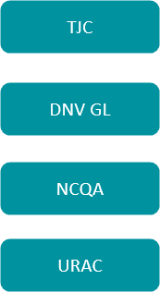
Delegate Authority
Notes:
Delegate authority – various accrediting bodies recognize delegate authority to streamline the credentialing process. In a hospital setting, TJC and DNV have similar requirements to expedite credentialing. In a managed care environment, NCQA and URAC allow for medical director approval for clean applications.

Slide 28
Provider Enrollment Recap
Enrollment is the process of applying to health insurance plans or payers to gain approval for participation in provider networks and to receive reimbursement for healthcare services provided.
Enrollment responsibilities include:
Commercial payers (delegated and non-delegated)
Medicare and State Medicaid
Reporting Adds, Changes and Terminations
Facility Enrollment
Re-enrollment and Revalidation
Ongoing enrollment activities
Notes:
During the Week 1 online module 2, the enrollment process was covered in great detail. Often considered as part of the onboarding process, the enrollment process will include the request to enroll and/or contract with a payer through completion of required documents that may include a credentialing application, enrollment forms, and other payer specific requirements..
Ask: What is the difference between enrollment and credentialing?
Enrollment is the process of submitting the application and supporting documents for the payers to use for credentialing. Credentialing is the actual processing of applications for participation, including verification and decision-making.
Ask: What are examples of payers for which an MSP would enroll a provider?
Government payers: Medicare / Medicaid
Commercial Payers, e.g., Aetna, Blue Cross Blue Shield, United Healthcare
Military/veterans: Tricare/TriWest
Workers’ Compensation
A key concept to remember is that enrollment is not the same as credentialing. Providers are enrolled with payers by submitting an application and supporting documents. Payers use that information to credential the provider following accreditation standards, such as NCQA and URAC, and CMS for managed care.
The key enrollment responsibilities were covered including how to enroll providers with commercial payers, both delegated and non-delegated, Medicare and State Medicaid. If an organization holds delegation status with a payer, the provider is credentialed internally by that organization. After providers are enrolled, regular reporting occurs including any changes in information and any providers that need to be terminated from the health plan. All new providers are enrolled following the same process, but under delegation, all of the provider data is submitted on a roster. Facilities are also enrolled, such as surgery centers, home health agencies, suppliers such as durable medical equipment or DME companies. In order for providers to maintain their participation status with a payer, re-enrollment must occur every 3 years with commercial payers for non-delegated entities. Under delegation, the organization must recredential the provider at least every 3 years and report those activities to the payer.
And lastly, the online course discussed the ongoing activities that are necessary for a successful enrollment process. Provider data must be maintained in the organization’s own database to support reporting and if required by payers, CAQH ProView data must also be maintained on a regular basis. Data accuracy is extremely important to ensure that providers are reflected in directories so that members can locate an appropriate provider and have correct contact information, especially in a delegation arrangement. Health plans undergo audits by CMS and may be penalized, including monetary fines, for having inaccurate data in a directory. It is also a good idea to regularly audit online directories to ensure your provider’s data is reflected correctly.

Slide 29
Activity: Enrollment Terminology Exercise
Review the terms and definitions with your group and determine the appropriate answer.
Instructions:
You will be placed in a virtual breakout group of 4-5
To join the virtual breakout, you must select “yes”
Note which group number you are in prior to selecting yes to join the group
8 minutes
15

Slide 30
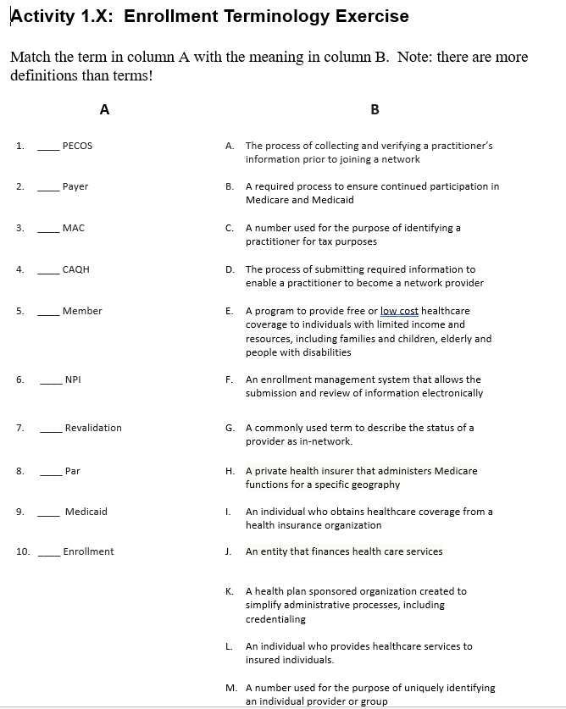
Debrief Enrollment Terminology
Notes:
Activity Enrollment Terminology Exercise – Answer Sheet
PECOS = F
Payer = J
MAC = H
CAQH = K
Member = I
NPI = M
Revalidation = B
Par = G
Medicaid = E
Enrollment = D

Slide 31
Activity: Knowledge Check
Notes:
We’d like to wrap up this session by challenging you and seeing what you remember in the form of a few quiz questions. We’re going to send out five different quiz questions, one at a time. For each question you’ll have a few moments to select your answer, then we’ll project the results on screen and discuss them.
Work with the NAMSS staff member to run through the polling questions below. Discuss each answer as they are projected onscreen.
Poll Discuss after each one based on responses (if wrong answer was selected, explain why).
1. Which of the following credentials must be tracked on an ongoing basis according to TJC?
Medical school completion
Closed medical malpractice claims
Licensure
2. Which of the following terms describes a step-by-step sequence for proper completion of a task?
Policy
Procedure
Rules
3. In an NCQA-accredited health plan, initial credentialing applications must be completed:
Within 180 days of receipt of a complete application
As specified in its credentialing policies
As designated by state regulation
4. Peer references should be obtained from:
Practitioners who have referred patients to the provider
Former hospital administrators
Practitioners in the same professional discipline as the applicant
5. When credentialing and privileging practitioners it is appropriate to:
Handle each applicant on a case-by-case basis
Follow a routine process for each applicant
Give preferential treatment to those providers whose specialty is primary care

Slide 32
Open Q&A

